Slide 1

Data Structures Using C++ 2E
Chapter 10
Sorting Algorithms

Slide 2
Objectives
Learn the various sorting algorithms
Explore how to implement selection sort, insertion sort, Shellsort, quicksort, mergesort, and heapsort
Discover how the sorting algorithms discussed in this chapter perform
Learn how priority queues are implemented
Data Structures Using C++ 2E

Slide 3
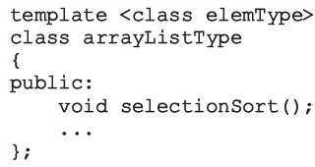
Sorting Algorithms
Several types in the literature
  Discussion includes most common algorithms
Analysis
  Provides a comparison of algorithm performance
Functions implementing sorting algorithms
  Included as public members of related class
Data Structures Using C++ 2E

Slide 4
Selection Sort: Array-Based Lists
List sorted by selecting elements in the list
  Select elements one at a time
  Move elements to their proper positions
  Either array-based list or linked list
Selection sort operation
  Find location of the smallest element in unsorted list portion
    Move it to top of unsorted portion of the list
  First time: locate smallest item in the entire list
  Second time: locate smallest item in the list starting from the second element in the list, and so on
Data Structures Using C++ 2E

Slide 5
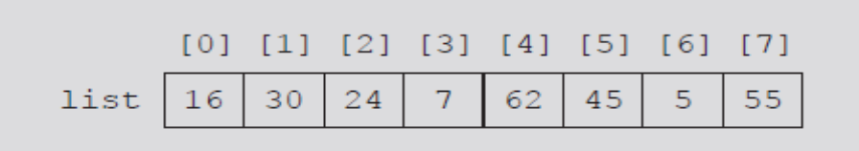
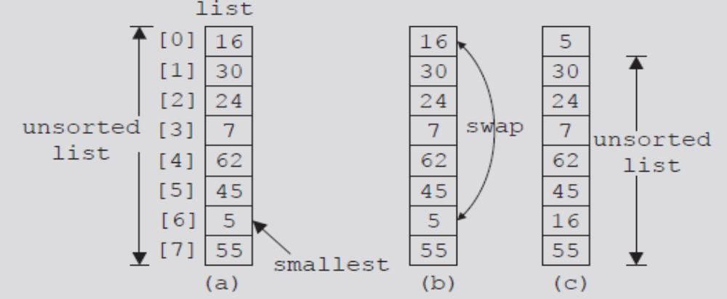
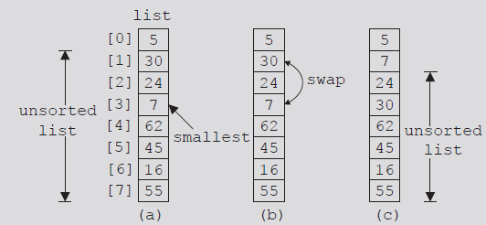
FIGURE 10-1 List of 8 elements
FIGURE 10-2 Elements of list during the first iteration
FIGURE 10-3 Elements of list during the second iteration
Data Structures Using C++ 2E

Slide 6
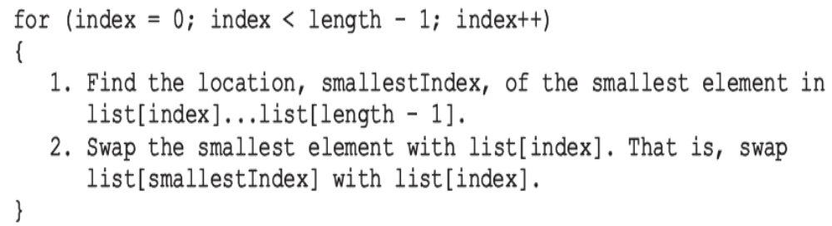
Selection Sort: Array-Based Lists (cont’d.)
Selection sort steps
  In the unsorted portion of the list
    Find location of smallest element
    Move smallest element to beginning of the unsorted list
Keep track of unsorted list portion with for loop
Data Structures Using C++ 2E

Slide 7
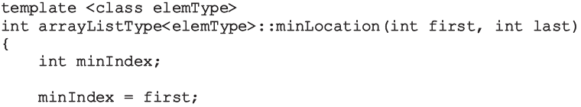
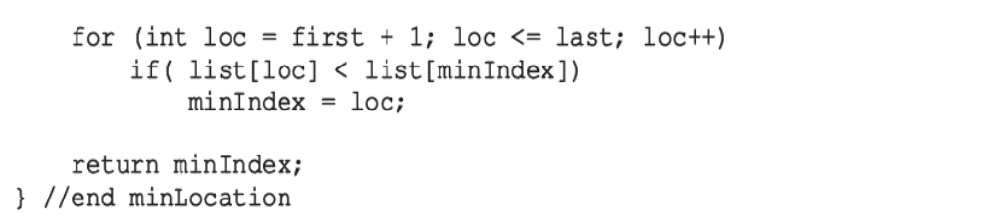
Selection Sort: Array-Based Lists (cont’d.)
starting index first, and ending index last
  C++ function returns index of the smallest element in list[first]...list[last]
O(n)
Data Structures Using C++ 2E

Slide 8
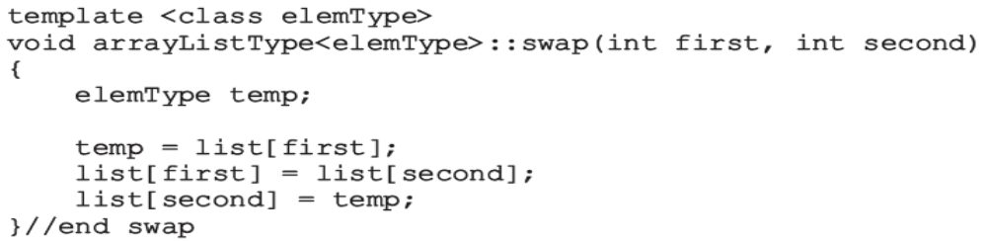
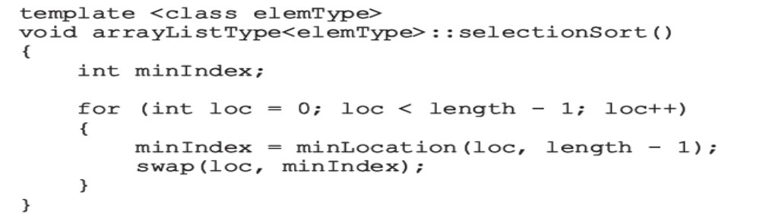
Selection Sort: Array-Based Lists (cont’d.)
Function swap
Function selectionSort
O(1)
O(n²)
Data Structures Using C++ 2E

Slide 9
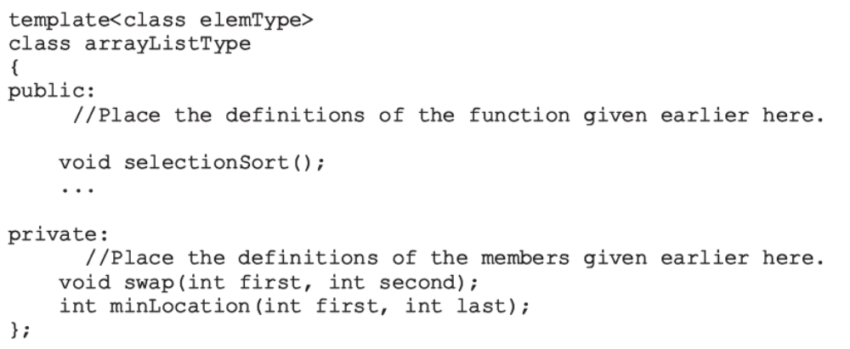
Selection Sort: Array-Based Lists (cont’d.)
Add functions to implement selection sort in the definition of class arrayListType
Data Structures Using C++ 2E

Slide 10
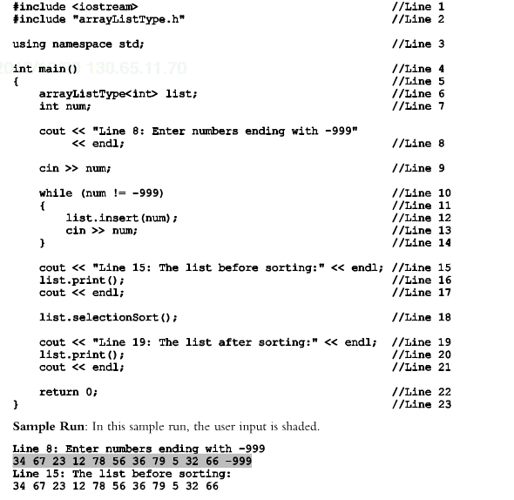

Data Structures Using C++ 2E

Slide 11
Analysis: Selection Sort
Search algorithms
  Concerned with number of key (item) comparisons
Sorting algorithms
  Concerned with number of key comparisons and number of data movements
Analysis of selection sort
  Function swap
    Number of item assignments: 3(n-1)
  Function minLocation and invocation
    Number of key comparisons of O(n²)
 | Best case | Avg case | Worst case
Selection sort | O(n²) | O(n²) | O(n²)
Data Structures Using C++ 2E

Slide 12
In Class Exercise
Start with the following list of numbers: 29, 43, 14, 62, 39, 55, 11, 18, 101, 99, what is the list after the 4th iteration of the for loop?
Data Structures Using C++ 2E
Notes:
11 43 14 62 39 55 29 18 101 99
11 14 43 62 39 55 29 18 101 99
11 14 18 62 39 55 29 43 101 99
11 14 18 29 39 55 62 43 101 99

Slide 13
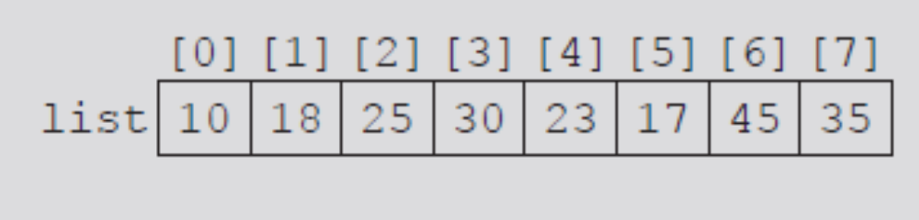
Insertion Sort: Array-Based Lists
Attempts to improve high selection sort key comparisons
Sorts list by moving each element to its proper place
Either array-based list or linked list
Given list of length eight
FIGURE 10-4 list
Data Structures Using C++ 2E

Slide 14
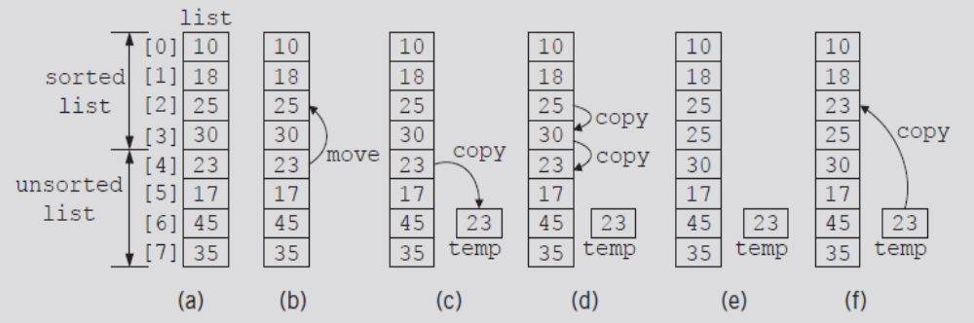
Insertion Sort: Array-Based Lists (cont’d.)
Elements list[0], list[1], list[2], list[3] in order
Consider element list[4]
  First element of unsorted list
FIGURE 10-5 list elements while moving list[4] to its proper place
Data Structures Using C++ 2E

Slide 15
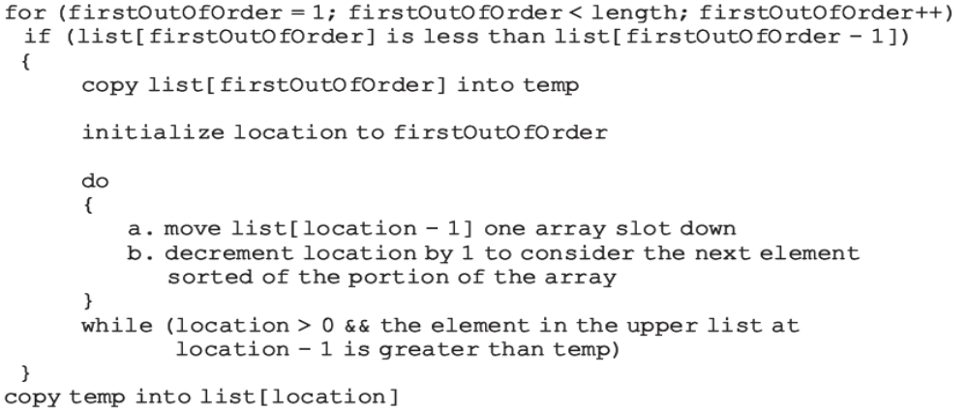
Insertion Sort: Array-Based Lists (cont’d.)
Array containing list divided into two sublists
  Upper (sorted) and lower (unsorted)
Index firstOutOfOrder
  Points to first element in the lower sublist
Data Structures Using C++ 2E

Slide 16
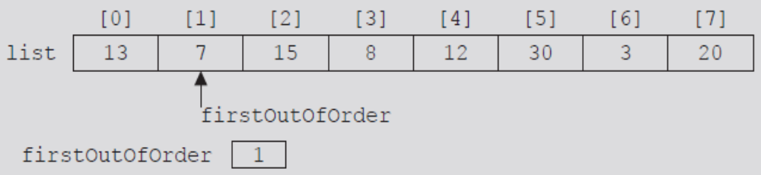
Insertion Sort: Array-Based Lists (cont’d.)
length = 8
Initialize firstOutOfOrder to one
FIGURE 10-6 firstOutOfOrder = 1
Data Structures Using C++ 2E

Slide 17
Insertion Sort: Array-Based Lists (cont’d.)
list[firstOutOfOrder] = 7
list[firstOutOfOrder - 1] = 13
  ➔ 7 < 13
Expression in if statement evaluates to true
  Execute body of if statement
    temp = list[firstOutOfOrder] = 7
    location = firstOutOfOrder = 1
  Execute the do...while loop
    list[1] = list[0] = 13
    location = 0
Data Structures Using C++ 2E

Slide 18
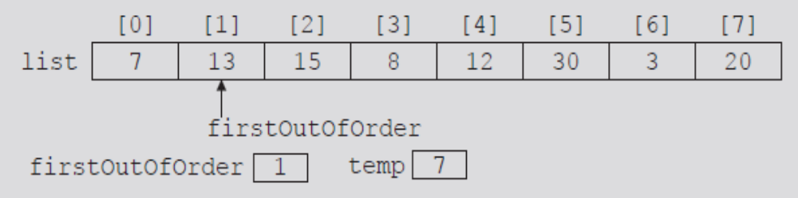
Insertion Sort: Array-Based Lists (cont’d.)
do...while loop terminates
  Because location = 0
    Copy temp into list[location] (list[0])
FIGURE 10-7 list after the first iteration of insertion sort
Data Structures Using C++ 2E

Slide 19
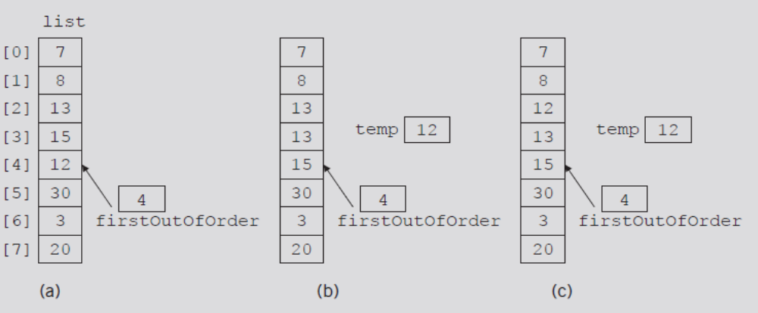
Insertion Sort: Array-Based Lists (cont’d.)
Suppose list given in Figure 10-8(a)
  Walk through code
FIGURE 10-8 list elements while moving list[4] to its proper place
Data Structures Using C++ 2E

Slide 20
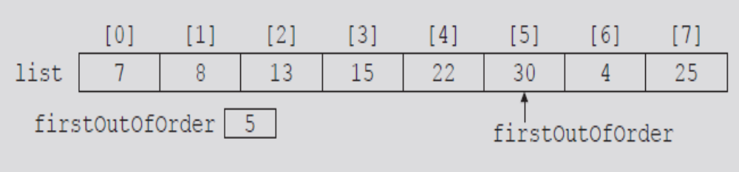
Insertion Sort: Array-Based Lists (cont’d.)
Suppose list given in Figure 10-9
  Walk through code
FIGURE 10-9 First out-of-order element is at position 5
Data Structures Using C++ 2E

Slide 21
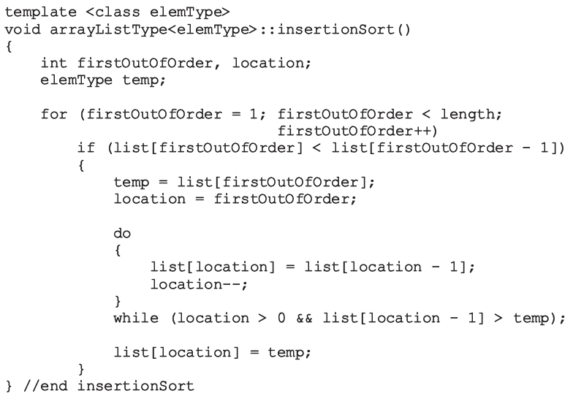
Insertion Sort: Array-Based Lists (cont’d.)
C++ function implementing previous algorithm
Data Structures Using C++ 2E

Slide 22
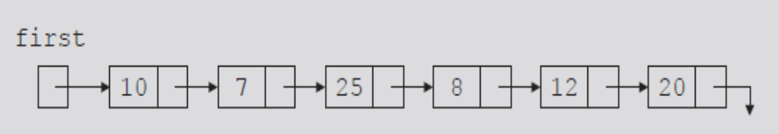
Insertion Sort: Linked List-Based Lists
If list stored in an array
  Traverse list in either direction using index variable
If list stored in a linked list
  Traverse list in only one direction
    Starting at first node: links only in one direction
FIGURE 10-10 Linked list
Data Structures Using C++ 2E

Slide 23
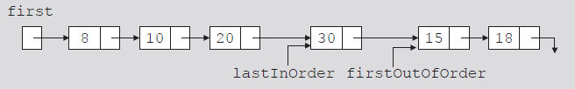
Insertion Sort: Linked List-Based Lists (cont’d.)
firstOutOfOrder
  Pointer to node to be moved to its proper location
lastInOrder
  Pointer to last node of the sorted portion of the list
FIGURE 10-11 Linked list and pointers lastInOrder
and firstOutOfOrder
Data Structures Using C++ 2E

Slide 24
Insertion Sort: Linked List-Based Lists (cont’d.)
Compare firstOutOfOrder info with first node info
  If firstOutOfOrder info smaller than first node info
    firstOutOfOrder moved before first node
  Otherwise, search list starting at second node to find location where to move firstOutOfOrder
Search list using two pointers
  current
  trailCurrent: points to node just before current
Handle any special cases
Data Structures Using C++ 2E

Slide 25
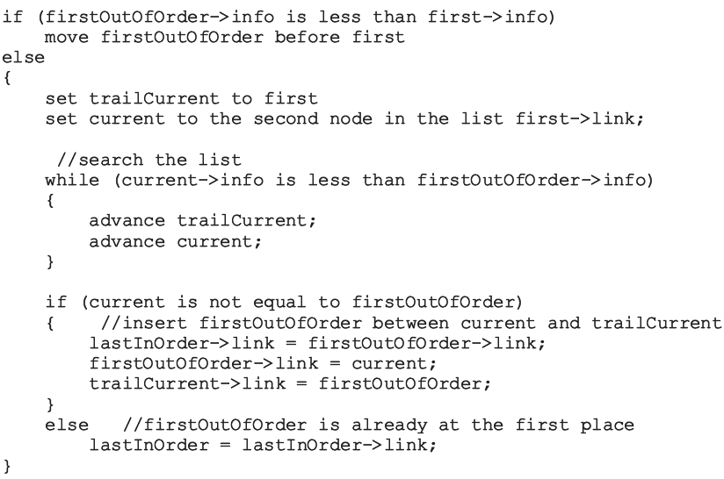
Insertion Sort: Linked List-Based Lists (cont’d.)
Data Structures Using C++ 2E

Slide 26
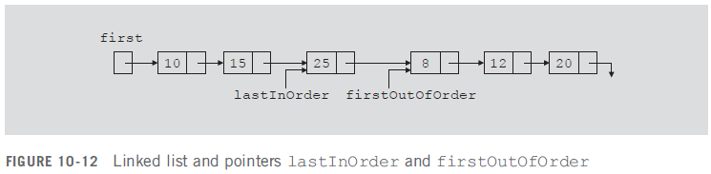
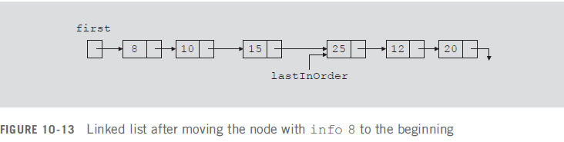
Insertion Sort: Linked List-Based Lists (cont’d.)
Case 1
  firstOutOfOrder->info less than first->info
    Node firstOutOfOrder moved before first
    Adjust necessary links
Data Structures Using C++ 2E

Slide 27
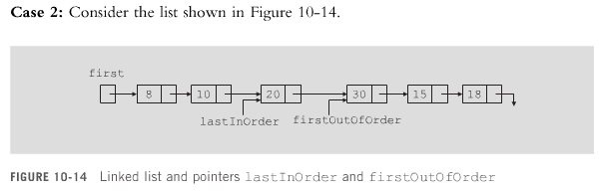
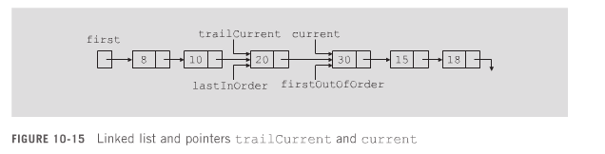
No adjustment – already in the right place
Data Structures Using C++ 2E

Slide 28
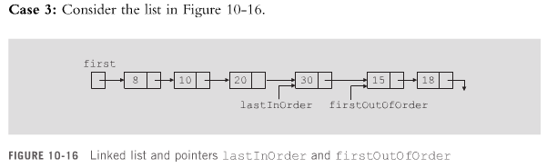
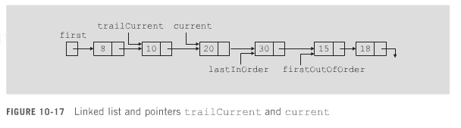
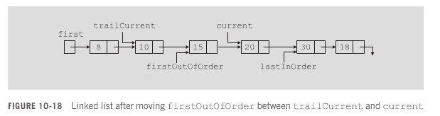
Data Structures Using C++ 2E

Slide 29
Insertion Sort: Linked List-Based Lists (cont’d.)
Review Case 2 on page 546
Review Case 3 on page 546
Review function linkedInsertionSort on page 547
  Implements previous algorithm
Data Structures Using C++ 2E

Slide 30
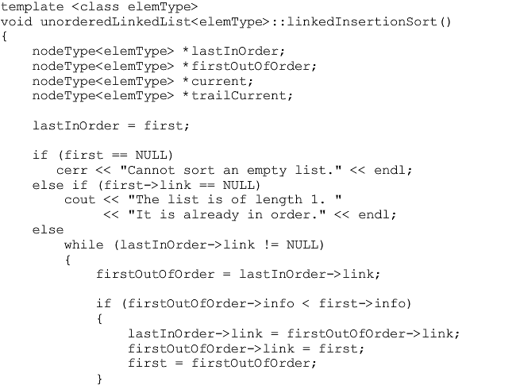
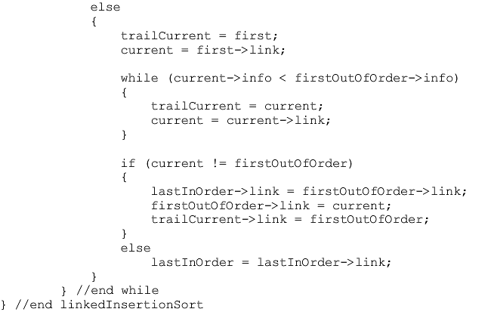
Data Structures Using C++ 2E

Slide 31
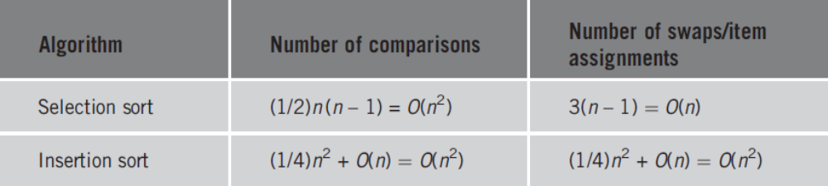
Analysis: Insertion Sort
TABLE 10-1 Average-case behavior of the selection sort and insertion sort for a list of length n
Insertion sort reduces # of comparisons, at the cost of more data movements
 | Best case | Avg case | Worst case
Selection sort | O(n²) | O(n²) | O(n²)
Insertion sort | O(n) | O(n²) | O(n²)
When?
When?
Data Structures Using C++ 2E
Notes:
Selection sort makes more comparisons but less movements, it moves item at most once, but insertion sort moves element one position at a time until the element moves to its final destination
Best-case behavior:
Selection sort: no
Insertion sort: sorted array
Worst case scenario:
Selection sort: no
Insertion sort: reverse sorted array

Slide 32
Shellsort
Reduces number of item movements in insertion sort by modifying it
  Introduced in 1959 by D.E. Shell
  Also known as diminishing-increment sort
List elements viewed as sublists at a particular distance
  Each sublist sorted
    Elements far apart move closer to their final position
  Next sequence, repeat
Given increment (gap) sequence 1, 4, 7
  Sort elements at a distance of 7, 4, 1
Data Structures Using C++ 2E

Slide 33
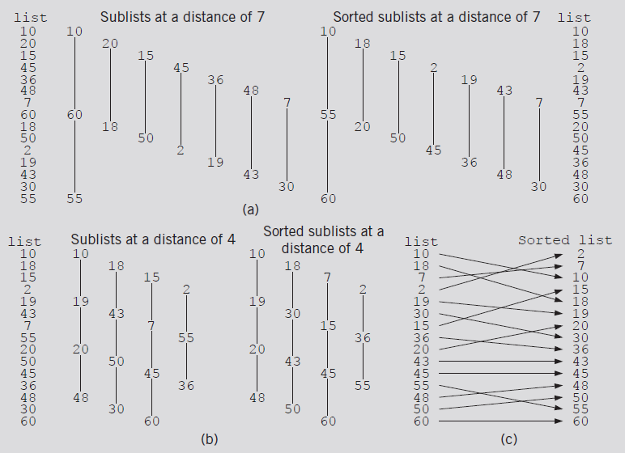
Shellsort (cont’d.)
FIGURE 10-19 Lists during Shellsort (7-4-1)
Data Structures Using C++ 2E

Slide 34
Shellsort (cont’d.)
Figure 10-19
  Increment (gap) sequence 1, 4, 7
  Sort elements at a distance of 7, 4, 1
Desirable to use as few increments as possible
D.E. Knuth recommended increment sequence
  1, 4, 13, 40, 121, 364, 1093, 3280. . . .
    Ratio between successive increments: about one-third
    i^{th} increment = 3 • (i – 1)th increment + 1
Certain increment sequences must be avoided: bad performance
  1, 2, 4, 8, 16, 32, 64, 128, 256. . . .
Data Structures Using C++ 2E

Slide 35
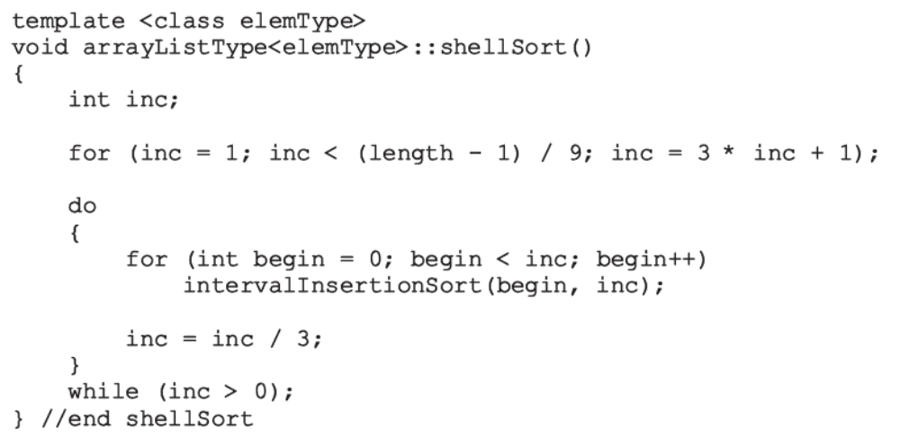
Shellsort (cont’d.)
Function implementing Shellsort algorithm
Max value in the increment sequence determined by this loop.
Find the largest inc that is less than length/3
Data Structures Using C++ 2E
Notes:
Programming exercise 4 for intervalInsertionSort
For example length=199
Notice the semicolon after for() statement: it finds the largest inc that doesn’t exceed length/3

Slide 36
Shellsort (cont’d.)
Function shellSort
  Uses function intervalInsertionSort
    Modified version of insertion sort for array-based lists
intervalInsertionSort
  Sublist starts at variable begin
  Increment between successive elements given by variable inc instead of one
Analysis of Shellsort
  Difficult to obtain, # of moves O(n^{1.25}) ~ O(1.6n^{1.25})
  Better than insertion sort
Data Structures Using C++ 2E

Slide 37
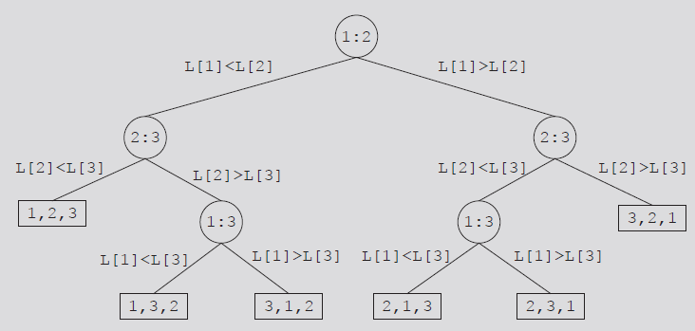
Lower Bound on Comparison-Based
Sort Algorithms
Comparison tree
  Graph tracing comparison-based algorithm execution
    Node: comparison drawn as a circle
    Leaf: rectangle representing final node ordering
    Root node: top node in the figure
    Branch: straight line connecting two nodes
    Path: sequence of branches between nodes
FIGURE 10-20 Comparison tree for sorting three items
Data Structures Using C++ 2E

Slide 38
Lower Bound on Comparison-Based
Sort Algorithms (cont’d.)
Unique permutation of the elements
  Associated with each path from the root to a leaf
  The tree has n! leaves
  Depth of the tree: log₂n
  Key comparisons at each level: O(n)
Theorem
  Let L be a list of n distinct elements. Any sorting algorithm that sorts L by comparison of the keys only, in its worst case, makes at least O(nlog₂n) key comparisons
    Better than selection/insert sort O(n²)
Data Structures Using C++ 2E

Slide 39
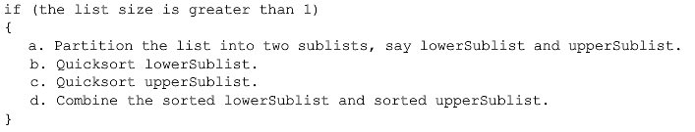
Quicksort: Array-Based Lists
Uses the divide-and-conquer technique to sort a list
  List partitioned into two sublists
    Two sublists sorted and combined into one list
    Combined list then sorted using quicksort (recursion)
Trivial to combine sorted lowerSublist and upperSublist
All sorting work done in partitioning the list (i.e., selecting the pivot)
Data Structures Using C++ 2E

Slide 40
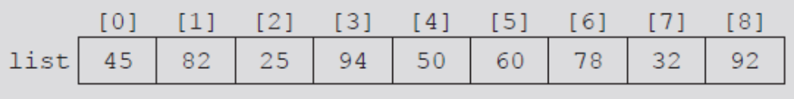

Quicksort: Array-Based Lists (cont’d.)
Pivot divides list into two sublists
  lowerSublist: elements smaller than pivot
  upperSublist: elements greater than pivot
  The pivot ends up in the correct place in the total order
  Two sublists can be sorted independently
Choosing the pivot
  Ideally, lowerSublist and upperSublist nearly equal.
  For simplicity, choose the middle element of the list
Two sublists can be sorted independently
FIGURE 10-21 List before the partition
Data Structures Using C++ 2E
FIGURE 10-22 List after the partition

Slide 41
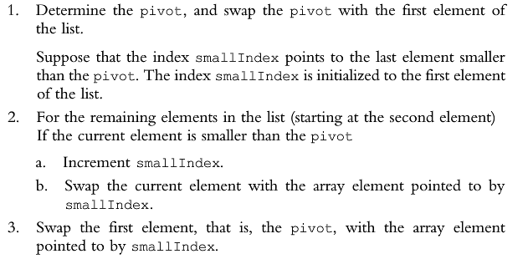
Quicksort Partition Algorithm
Partition algorithm
Data Structures Using C++ 2E

Slide 42
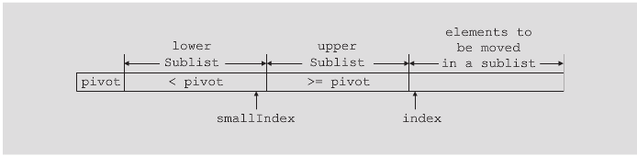
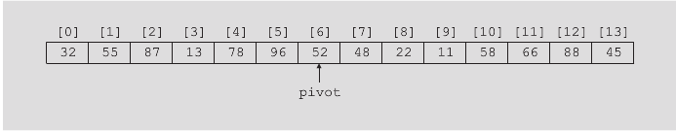
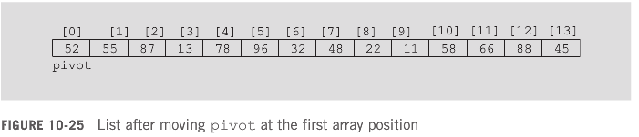
Quicksort Example
Data Structures Using C++ 2E

Slide 43
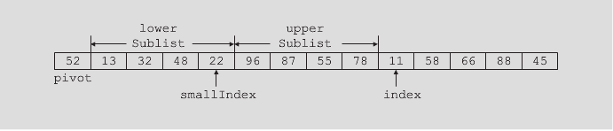
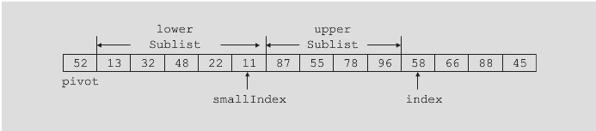
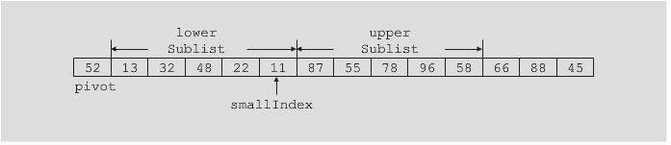
Quicksort Example
Data Structures Using C++ 2E

Slide 44
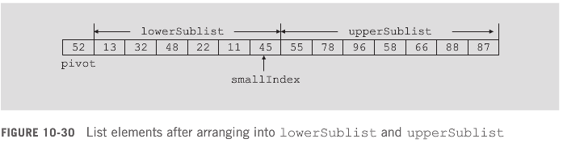
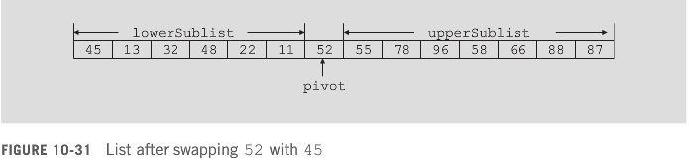
Quicksort Example
Step 3
Data Structures Using C++ 2E

Slide 45
Quicksort: Array-Based Lists (cont’d.)
Recap: Partition algorithm
  Determine pivot; swap pivot with first list element
    Suppose index smallIndex points to last element smaller than pivot. smallIndex initialized to first list element
  For the remaining list elements (starting at second element): If current element smaller than pivot
    Increment smallIndex
    Swap current element with array element pointed to by smallIndex
  Swap first element (pivot) with array element pointed to by smallIndex
Data Structures Using C++ 2E

Slide 46
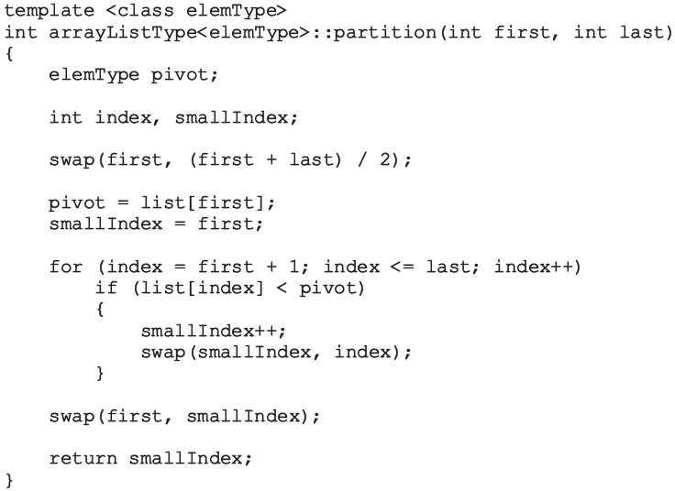
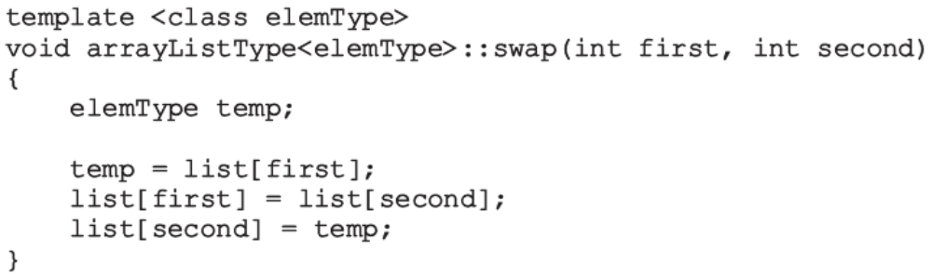
Quicksort: Array-Based Lists (cont’d.)
Function partition
  Passes starting and ending list indices
  Swaps certain elements of the list
Data Structures Using C++ 2E

Slide 47
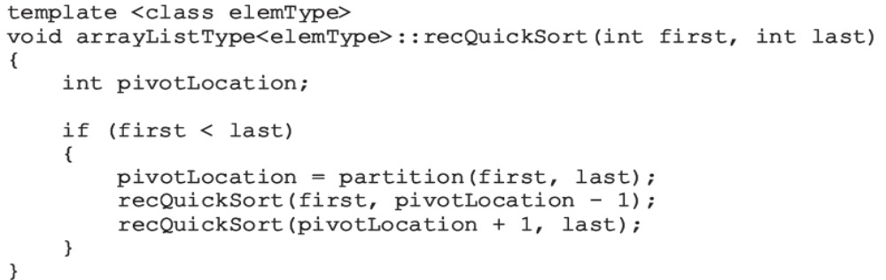
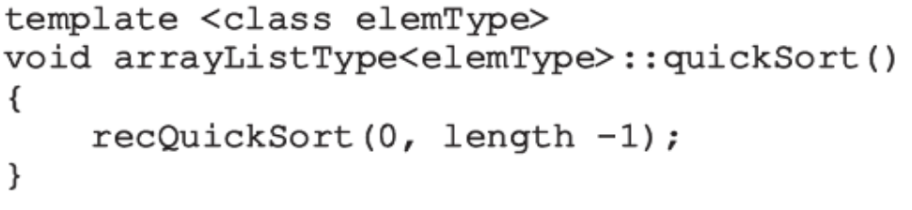
Quicksort: Array-Based Lists (cont’d.)
Given starting and ending list indices
  Function recQuickSort implements the recursive version of quicksort
Function quickSort calls recQuickSort
Data Structures Using C++ 2E
Notes:
Go over the stopping conditions
1. There are 2 elements left: First + 1 = last,
pivot = first, call recQuickSort(first, first-1) and recQuickSort(last, last)
2. There are 3 elements left: first+2=last
pivot = first+1, call recQuickSort(first, first) and recQuickSort(last, last)

Slide 48
Quicksort: In Class Exercise
Assume pivot is always the middle element
  Left to pivot: values less than pivot
  Right to pivot: values greater than pivot
  The element order in each sublist does not matter
[0]: 16 38 54 80 22 65 55 48 64 95 5 100 58 25 36
[1]: 16 38 22 5 25 36 48 54 80 65 55 64 95 100 58
[2]: 16 5 22 38 25 36 48 54 55 80 65 64 95 100 58
[3]: 5 16 22 25 38 36 48 54 55 58 64 80 65 95 100
[4]: 5 16 22 25 36 38 48 54 55 58 64 65 80 95 100
[5]: 5 16 22 25 36 38 48 54 55 58 64 65 80 95 100
[6]: 5 16 22 25 36 38 48 54 55 58 64 65 80 95 100
Data Structures Using C++ 2E

Slide 49
Quicksort: In Class Exercise 2
Fix two elements of the input array. How many times can these two elements get compared with each other during the execution of Quicksort?
  1
  0 or 1
  0, 1, or 2
  Any integer between 0 and n-1
Data Structures Using C++ 2E
Notes:
B: two elements are compared only when one is selected as the pivot, which is excluded from future recursive calls

Slide 50
Quicksort: Linked List-Based
Similar algorithm
Programming Exercise 10.7
Data Structures Using C++ 2E

Slide 51

Analysis: Quicksort
TABLE 10-2 Analysis of quicksort for a list of length n
 | Best case | Avg case | Worst case
Quicksort | O(nlog₂ n) | O(nlog₂ n) | O(n²)
When?
Data Structures Using C++ 2E
Notes:
When pivot is largest or smallest value

Slide 52
Mergesort: Linked List-Based Lists
Quicksort
  Uses divide-and-conquer technique to sort a list
  Average-case behavior: O(nlog₂n)
  Worst-case behavior: O(n²)
Mergesort behavior: always O(nlog₂n)
  Uses divide-and-conquer technique to sort a list
  Partitions list into two sublists
    Sorts sublists
    Combines sorted sublists into one sorted list
Difference between mergesort and quicksort
  How list is partitioned
Data Structures Using C++ 2E

Slide 53

Mergesort: Linked List-Based Lists (cont’d.)
FIGURE 10-32 Mergesort algorithm
Data Structures Using C++ 2E

Slide 54

Mergesort: Linked List-Based Lists (cont’d.)
Most sorting work done in merging sorted sublists
General algorithm for mergesort
Data Structures Using C++ 2E

Slide 55
Divide
To divide list into two sublists
  Need to find middle node
  Use two pointers: middle and current
    Loop: whenever middle advances by one, current advances by two
    current becomes NULL; middle points to last node of 1st sublist
  Divide list into two sublists
    Using the link of middle: assign pointer to node following middle
    Set link of middle to NULL
See function divideList on page 561
Data Structures Using C++ 2E

Slide 56


Data Structures Using C++ 2E

Slide 57



FIGURE 10-33 Unsorted linked list
FIGURE 10-34 middle and current before traversing the list
FIGURE 10-35 middle after traversing the list
FIGURE 10-36 List after dividing it into two lists
Data Structures Using C++ 2E

Slide 58
Merge
Once sublists sorted
  Next step: merge the sorted sublists
Merge process
  Compare elements of the sublists
  Adjust references of nodes with smaller info
See code on page 564 and 565
Data Structures Using C++ 2E

Slide 59



Data Structures Using C++ 2E

Slide 60


Data Structures Using C++ 2E

Slide 61


Data Structures Using C++ 2E

Slide 62
Mergesort: Array-based
Similar algorithm
Data Structures Using C++ 2E

Slide 63
Analysis: Mergesort
Maximum number of comparisons made by mergesort: O(n log₂n)
Let n = 2^{m}
  m = log₂n
  Recursive level is m
  Key comparison at each level O(n)
  Maximum key comparisons: O(nm), or O(n log₂n)
W(n) worst case key comparisons
  W(n) = O(n log₂n)
Let A(n) avg case key comparisons
  If n is a power of 2, A(n) = n log₂n - 1.25n = O(n log₂ n)
 | Best case | Avg case | Worst case
Mergesort | O(nlog₂ n) | O(nlog₂ n) | O(nlog₂ n)
Data Structures Using C++ 2E

Slide 64

Heapsort: Array-Based Lists
Overcomes quicksort worst case O(n²)
Heap: a binary tree with two properties
  It is complete
    Each level of tree completely filled except the bottom level
    Nodes in bottom level are filled from left to right
  It satisfies heap-order property
    Data in in each node >= data in children nodes
Which one is a heap?
Data Structures Using C++ 2E
Notes:
A is a heap

Slide 65

Heapsort: Array-Based Lists (cont’d)
Heap: list in which each element contains a key
  Key in the element at position k in the list
    At least as large as the key in the element at position 2k + 1 (if it exists) and 2k + 2 (if it exists)
C++ array index starts at zero
  Element at position k: k + 1th element of the list
FIGURE 10-41 A heap
FIGURE 10-42 Complete binary tree corresponding to the list in Figure 10-41

Slide 66
Heapsort: Array-Based Lists (cont’d.)
Heapsort
  First step: convert list into a heap
    Called buildHeap
  After converting the array into a heap
    Sorting phase begins
Data Structures Using C++ 2E

Slide 67


Heap building:
Build heap for tree rooted at list[index]
Build heap for tree rooted at list[index-1]
…
The position of the last element in the list which is not a leaf: (length/2 – 1).
Index = 4, val = 56
Data Structures Using C++ 2E

Slide 68


Build heap at list[4]
Build heap at list[3]
Build heap at list[2]
Build heap at list[1]
Data Structures Using C++ 2E

Slide 69


Build heap at list[0]
max
max
Data Structures Using C++ 2E

Slide 70

Build Heap
Function heapify
  Restores the heap in a subtree
  Implements the buildHeap function
    Converts list into a heap
Data Structures Using C++ 2E

Slide 71

Build Heap (cont’d)
low: index of the root node of the subtree
high: index of the last element in the list
Data Structures Using C++ 2E

Slide 72

Data Structures Using C++ 2E

Slide 73


Build Heap (cont’d.)
The heapsort algorithm
FIGURE 10-48 Heapsort
Data Structures Using C++ 2E

Slide 74
Heapsort: exercise
Given the following list of elements,
    13 31 56 45 34 22 107 99
  what is your heap after running function buildHeap?
  what does your tree look like after each iteration of heapSort?
Data Structures Using C++ 2E

Slide 75
Analysis: Heapsort
Given L a list of n elements where n > 0
Worst case
  Number of key comparisons to sort L
    2nlog₂n + O(n)
  Number of item assignments to sort L
    nlog₂n + O(n)
Average number of comparisons to sort L
  O(nlog₂n)
Heapsort takes twice as long as quicksort
  Avoids the slight possibility of poor performance
Data Structures Using C++ 2E

Slide 76
Time-complexity of Various Sort Algorithms
 | Best case | Avg case | Worst case
Selection sort | O(n²) | O(n²) | O(n²)
Bubble sort | O(n) | O(n²) | O(n²)
Insertion sort | O(n) | O(n²) | O(n²)
Shellsort | depending on increment (gap) sequence | depending on increment (gap) sequence | depending on increment (gap) sequence
Quicksort | O(nlog₂ n) | O(nlog₂ n) | O(n²)
Mergesort | O(nlog₂ n) | O(nlog₂ n) | O(nlog₂ n)
Heapsort | O(nlog₂ n) | O(nlog₂ n) | O(nlog₂ n)
Data Structures Using C++ 2E

Slide 77
Priority Queues (Revisited)
Customers or jobs with higher priorities
  Pushed to front of the queue
Assume priority of the queue elements is assigned using the relational operators
  In a heap, largest list element is always the first element of the list
  After removing largest list element
    Function heapify restores the heap in the list
  Implement priority queues as heaps
    To ensure largest element of the priority queue is always the first element of the queue
Data Structures Using C++ 2E

Slide 78
Priority Queues (Revisited) (cont’d.)
Insert an element in the priority queue
  Insert new element in first available list position
    Ensures array holding the list is a complete binary tree
  After inserting new element in the heap, the list might no longer be a heap
    Restore the heap (might result in moving the new entry to the root node)
Data Structures Using C++ 2E

Slide 79
Priority Queues (Revisited) (cont’d.)
Remove an element from the priority queue
  Assume priority queue implemented as a heap
    Copy last element of the list into first array position
    Reduce list length by one
    Restore heap in the list
  Other operations for priority queues
    Can be implemented in the same way as implemented for queues
Data Structures Using C++ 2E

Slide 80
Summary
Sort: key comparison + data swap/movement
Selection sort, insertion sort, Shellsort, quicksort, mergesort, and heapsort
  How does each algorithm work
  Time complexity
  Comparisons among them
  Pros and cons
  Which algorithm should be used under what situation
  Quicksort is mostly popular: heapsort takes twice as long as quicksort
  Implementation
Lower bound of time complexity
Data Structures Using C++ 2E
Notes:
Which algorithm shall I use?
Quicksort is mostly popular: heapsort takes twice as long as quicksort

Slide 81
Self Exercises
Programming Exercises: 1, 4, 7, 8, 10, 11
Data Structures Using C++ 2E

